Slide 1
Responsible Ecosystem-Based Solutions

Slide 2
Providing environmental consulting services, resource planning and management solutions to government, non-profit, industry and tourism sectors

Slide 3
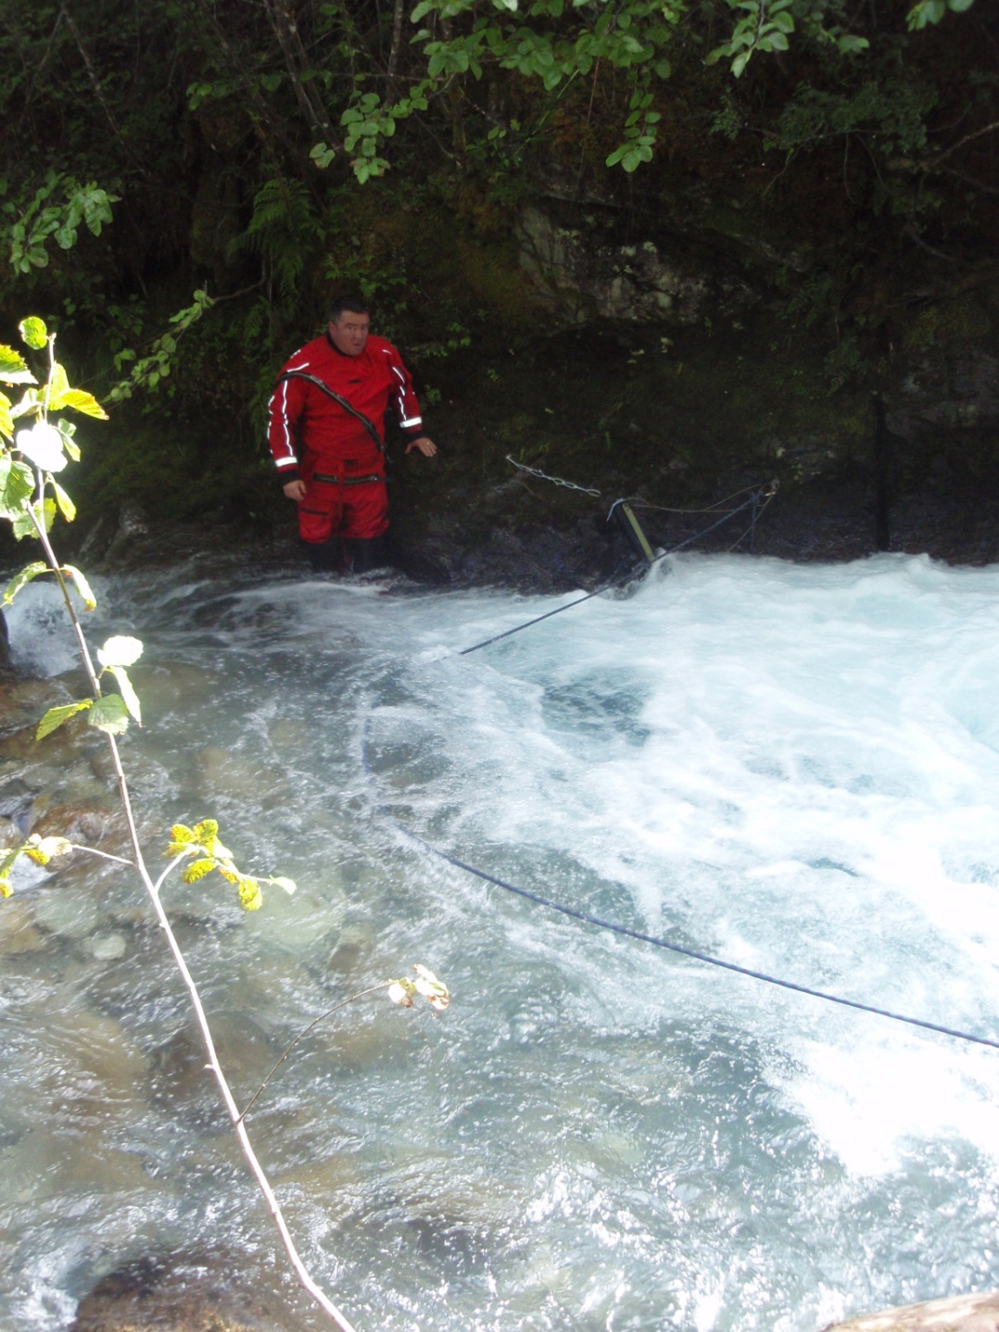
Clients include government agencies, recreation and resort operators, natural resource companies, land developers, and public stakeholder groups.

Slide 5
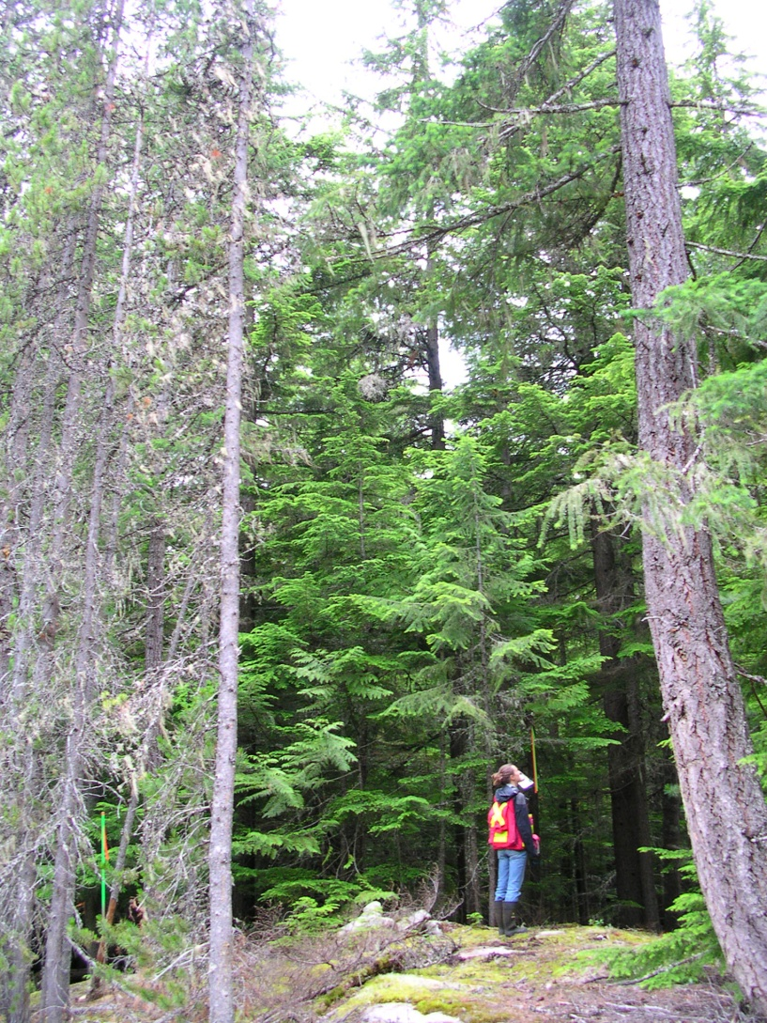
Habitat management
Habitat mitigation and compensation are often required for land use and development permits.

Slide 6
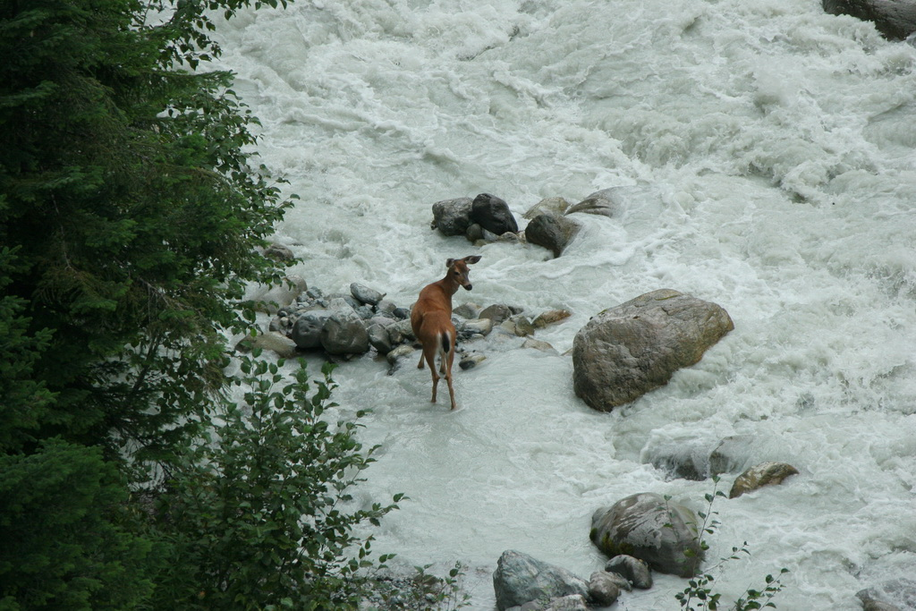
Habitat management
The goal of many habitat management projects is to encourage wildlife breeding and foraging by constructing or rehabilitating a deteriorated habitat.

Slide 7
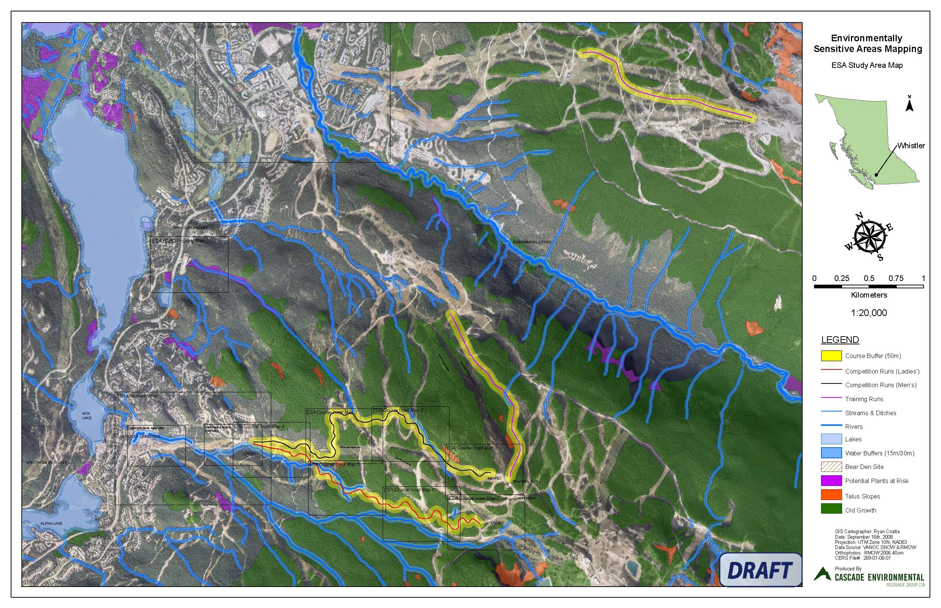

Slide 9
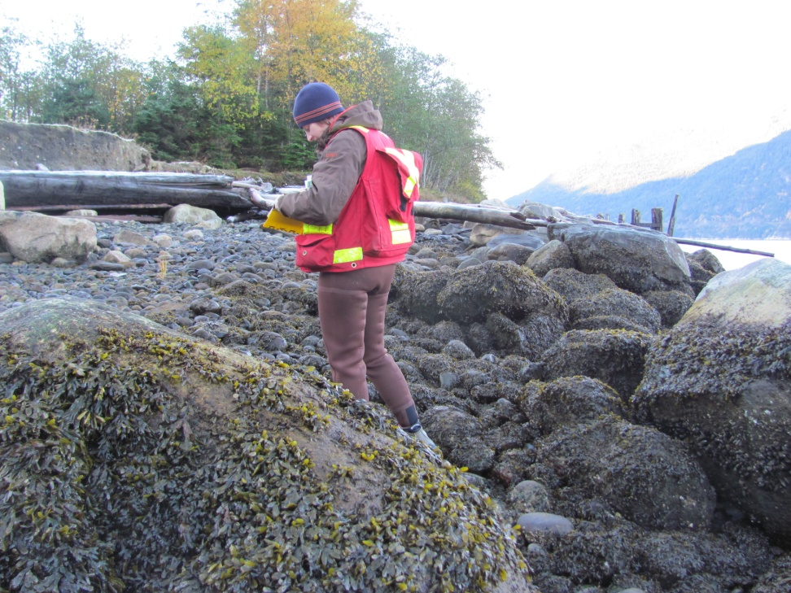
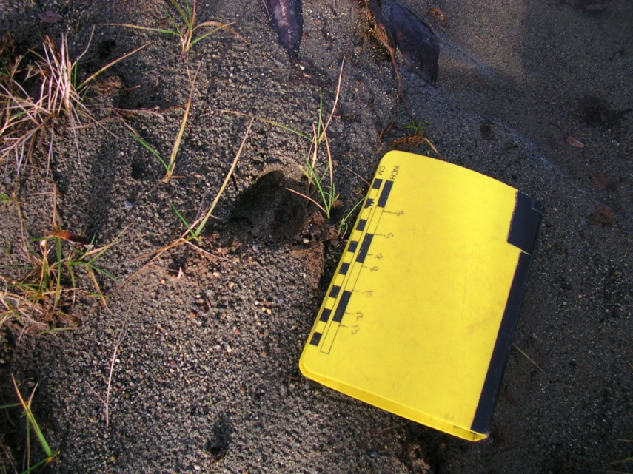
Environmental assessments
Assessments are required for a variety of projects and include Environmental Reviews, Terrestrial Ecosystem Mapping (TEM), Impact Assessments, and cumulative effects assessments.

Slide 10
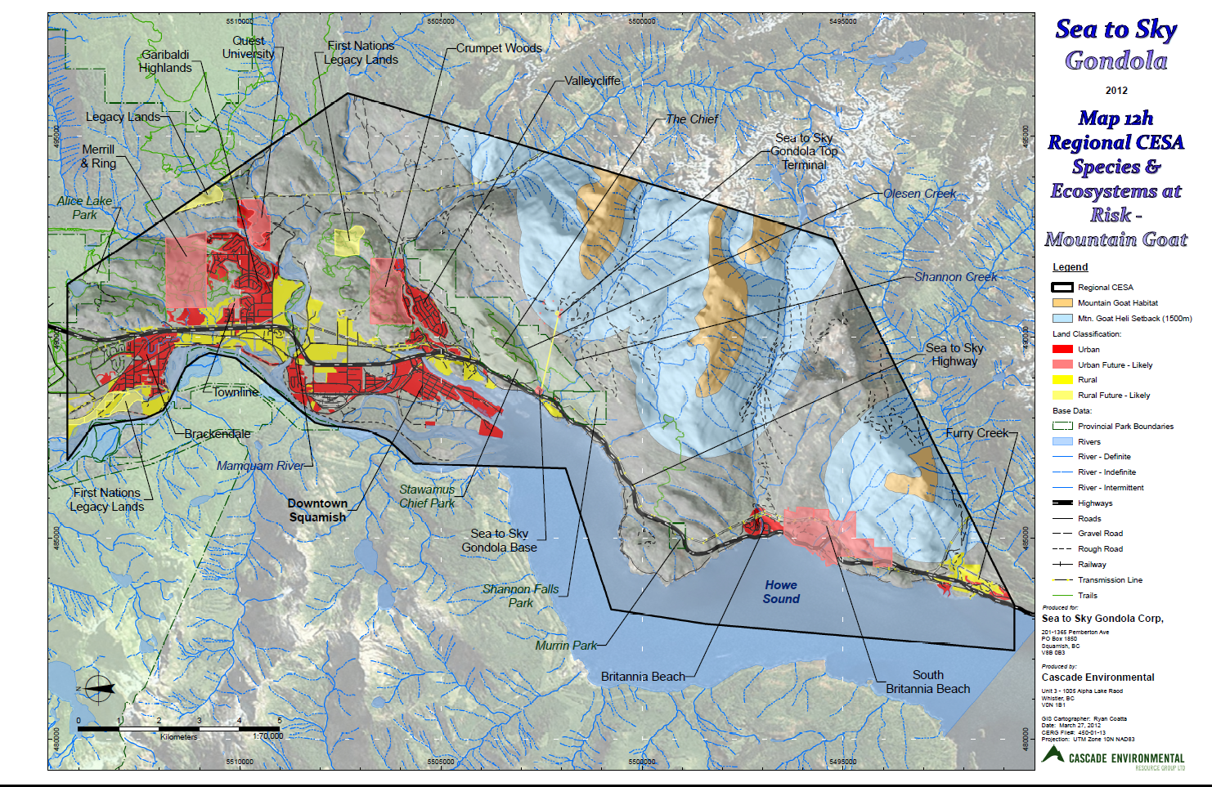

Slide 11
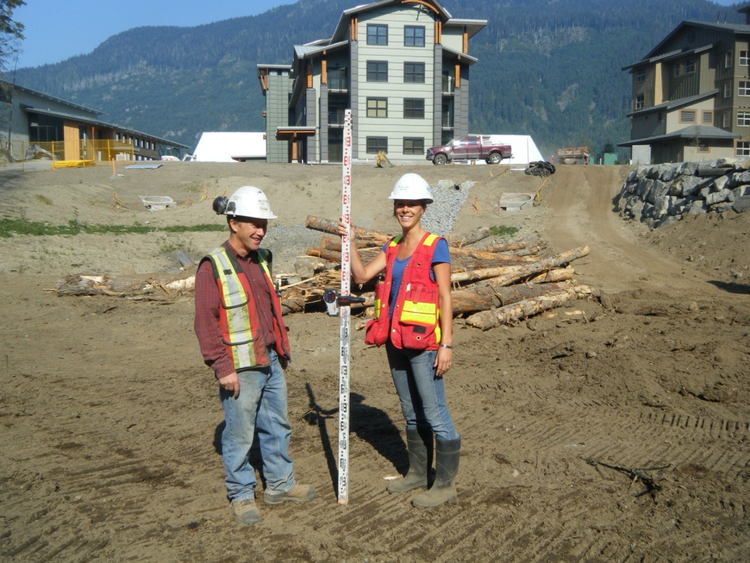
Construction monitoring
Cascade provides professional and experience-based mitigation techniques to ensure compliance with environmental regulations and to promote environmental best management practices.

Slide 12
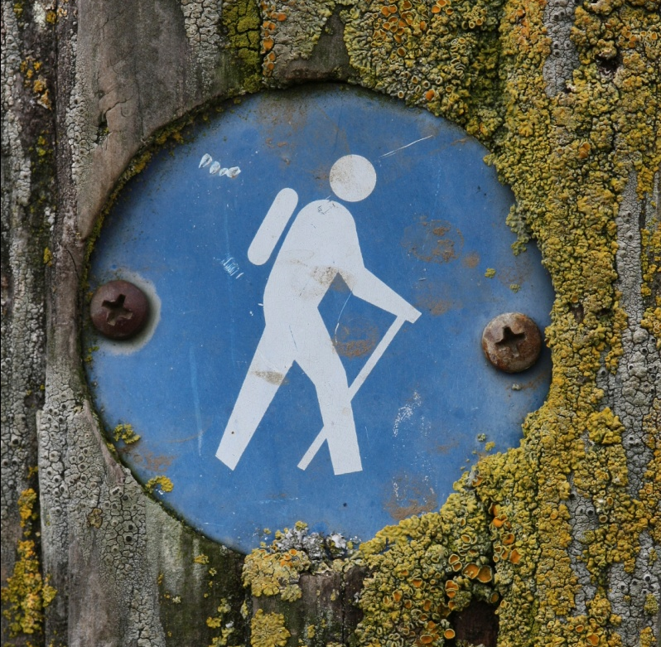
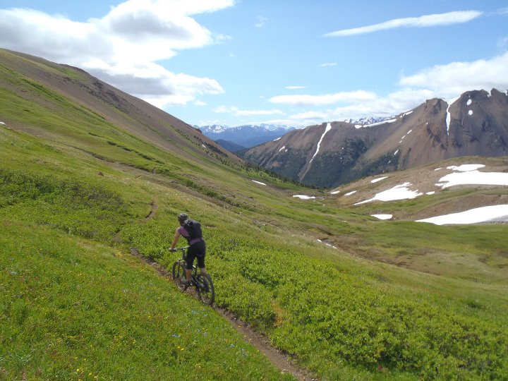
recreation
Recreation strategies provide land managers with decision-making tools and direction for successful recreation planning.

Slide 13
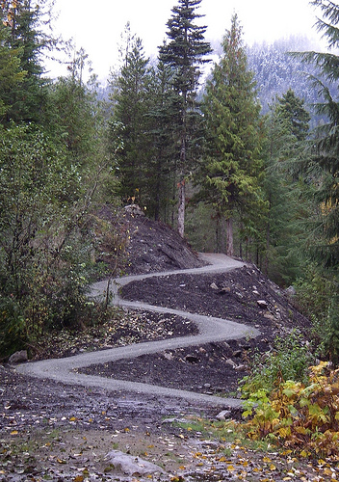
Recreation
Services include
recreation plans,
signage strategies,
bike park design, and
trail development.

Slide 14
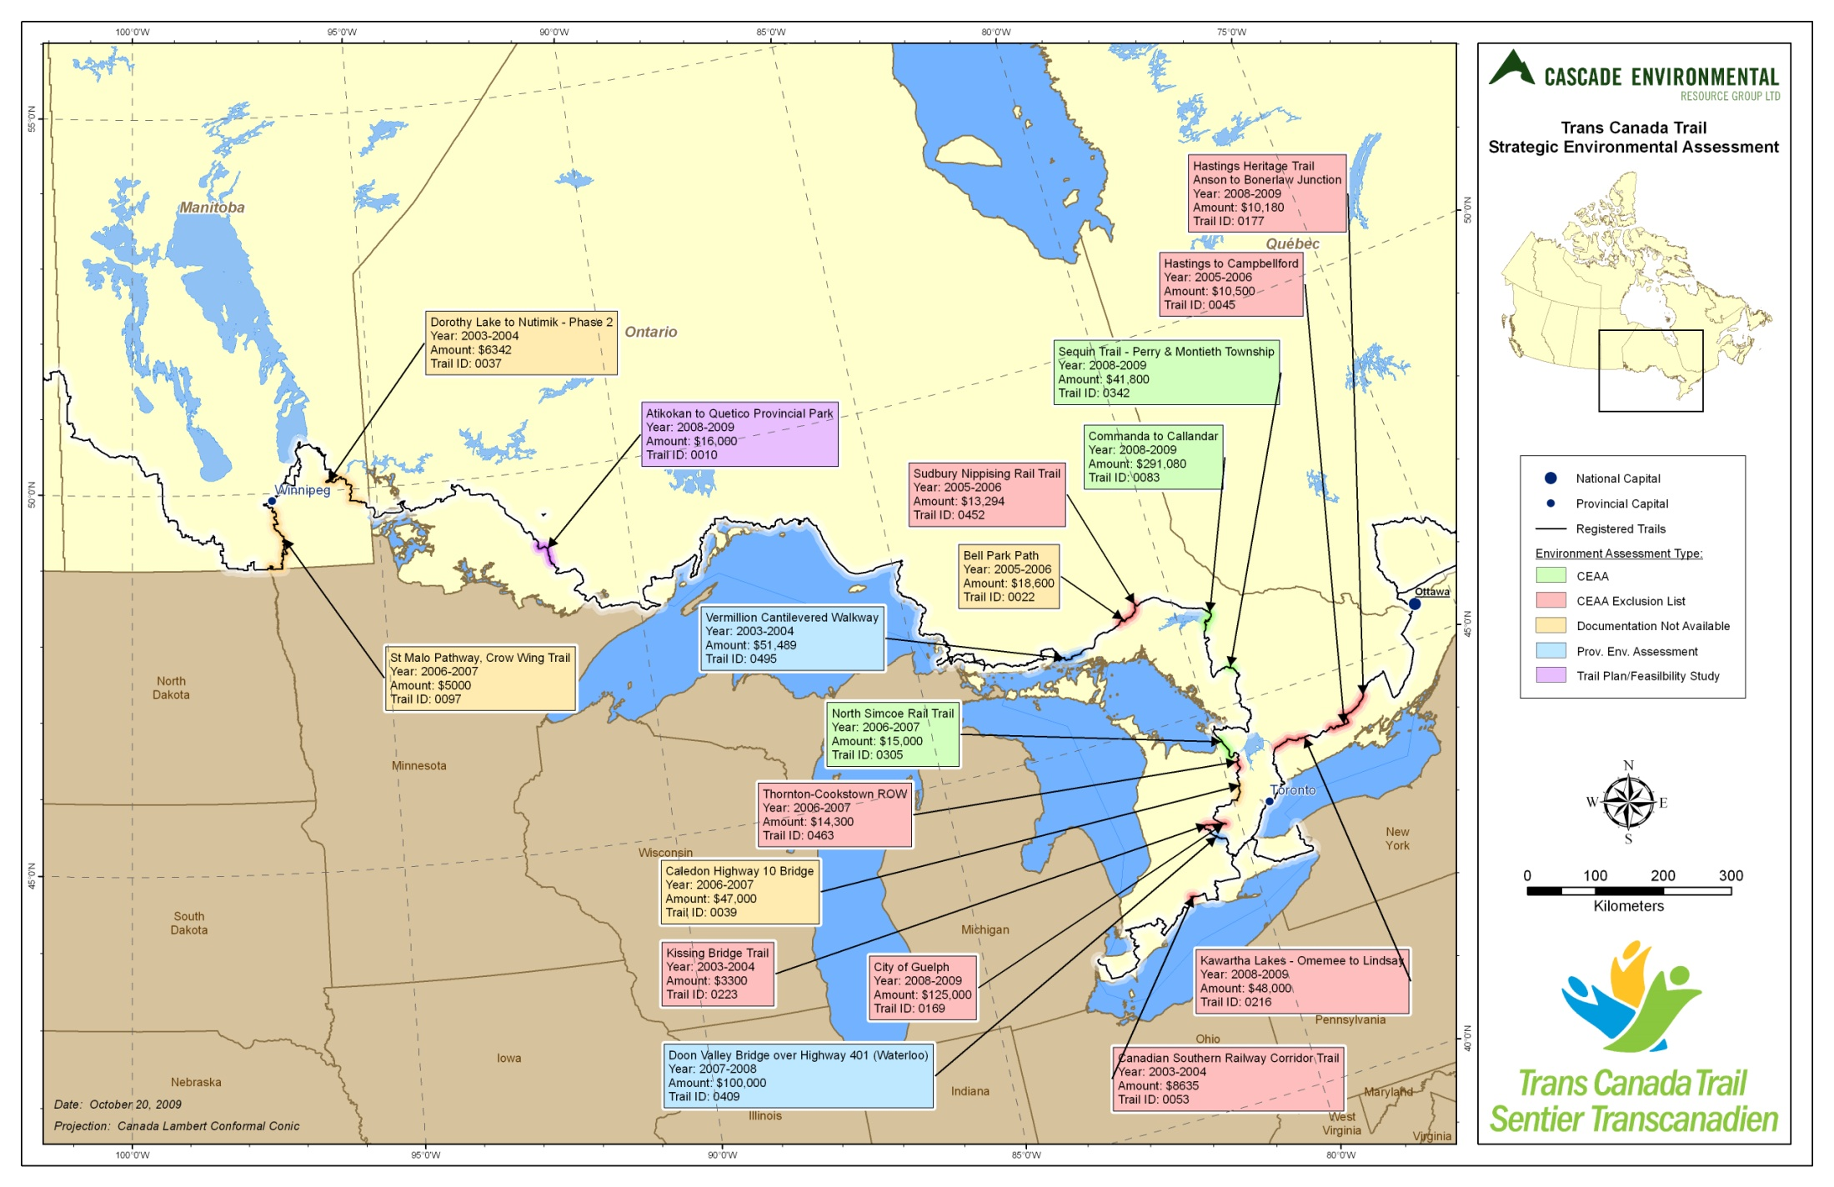

Slide 15
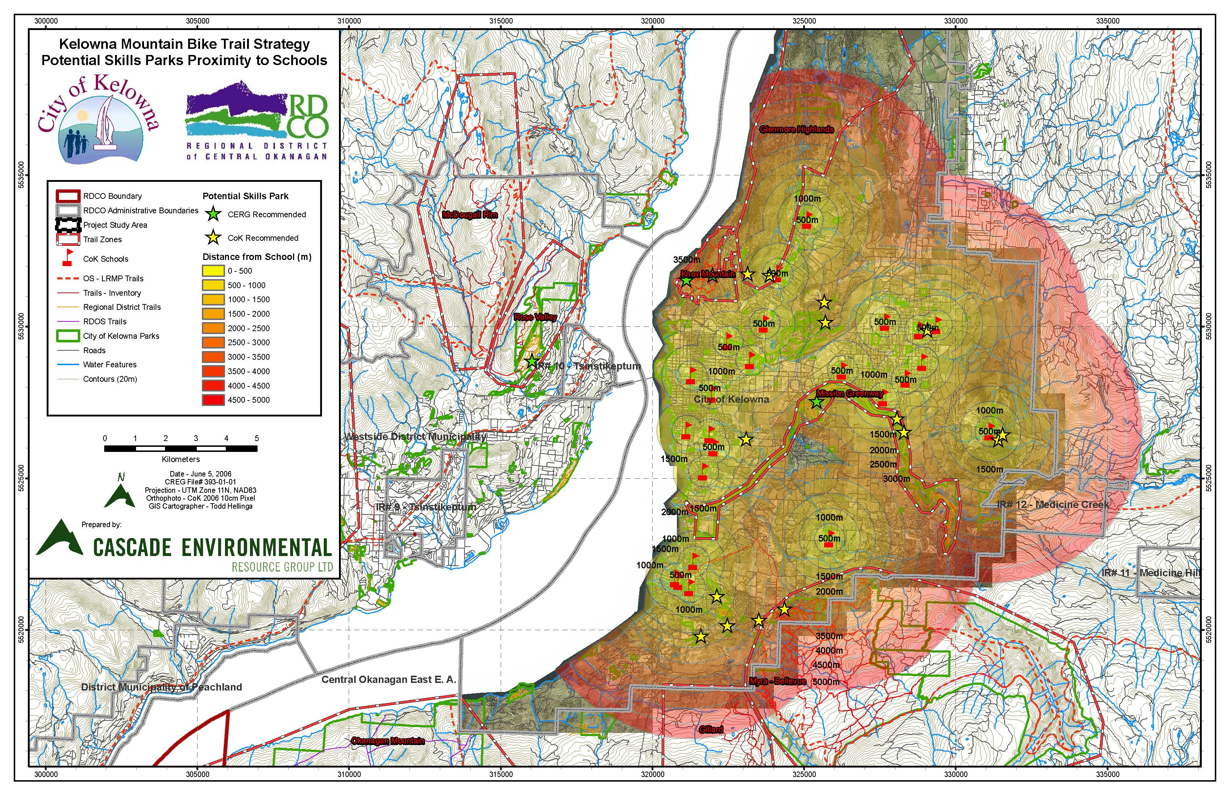

Slide 16
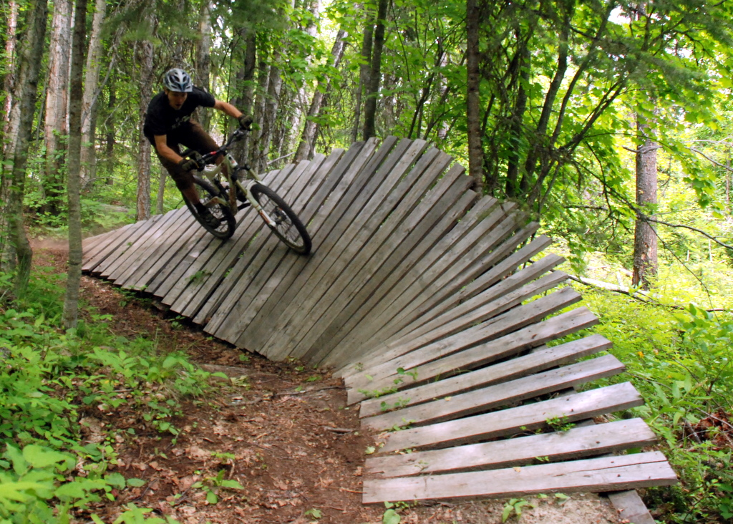
Strategic planning
Cascade works with recreation and resort developers to develop long-term ecosystem-based management strategies for future development that comply with necessary government regulations and to promote environmental stewardship.

Slide 17
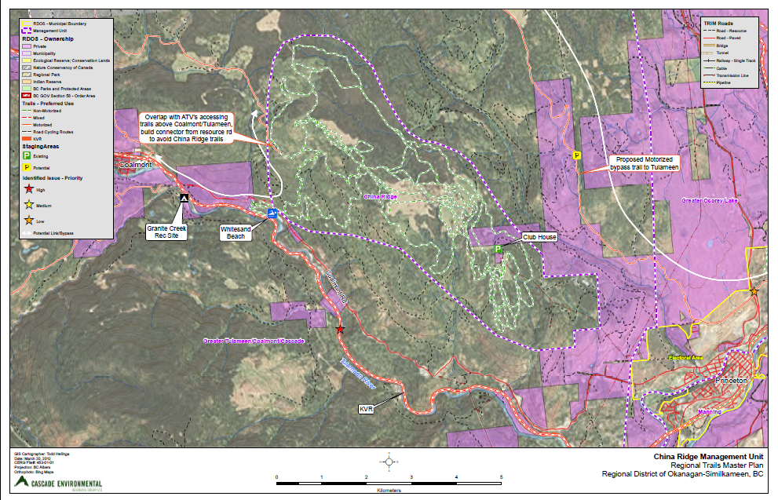

Slide 19
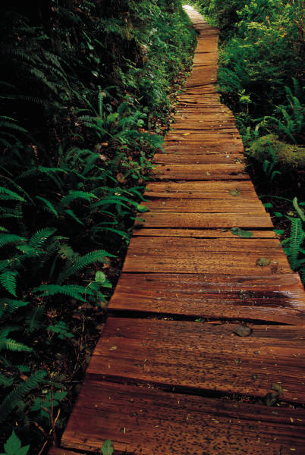
Trail design
Cascade designs trails and completes wildlife & vegetation impact assessments, as well as cost estimates for trail building, re-alignment, maintenance, upgrades, and mapping.

Slide 20
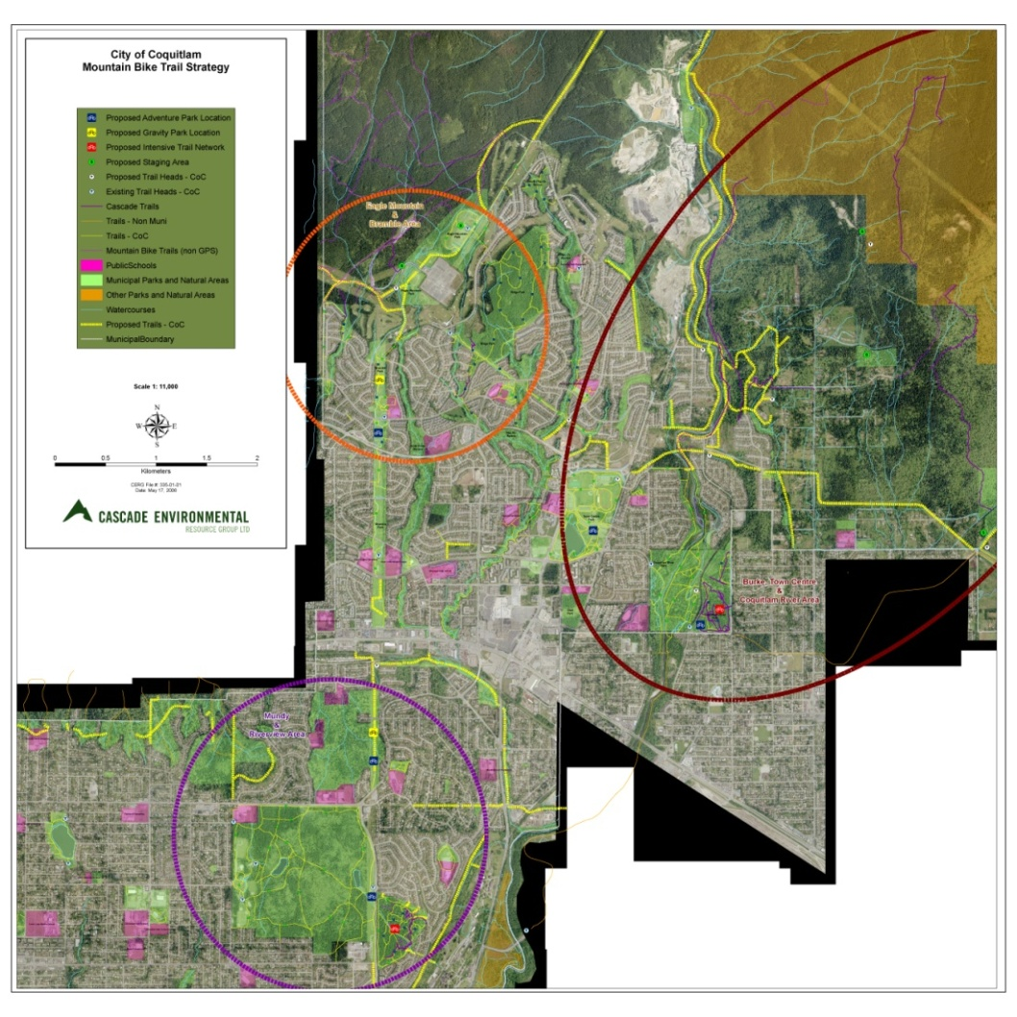
Mapping and gis
Cascade performs spatial analysis, provides high accuracy GPS surveying, and produces top quality cartographic mapping output.

Slide 21
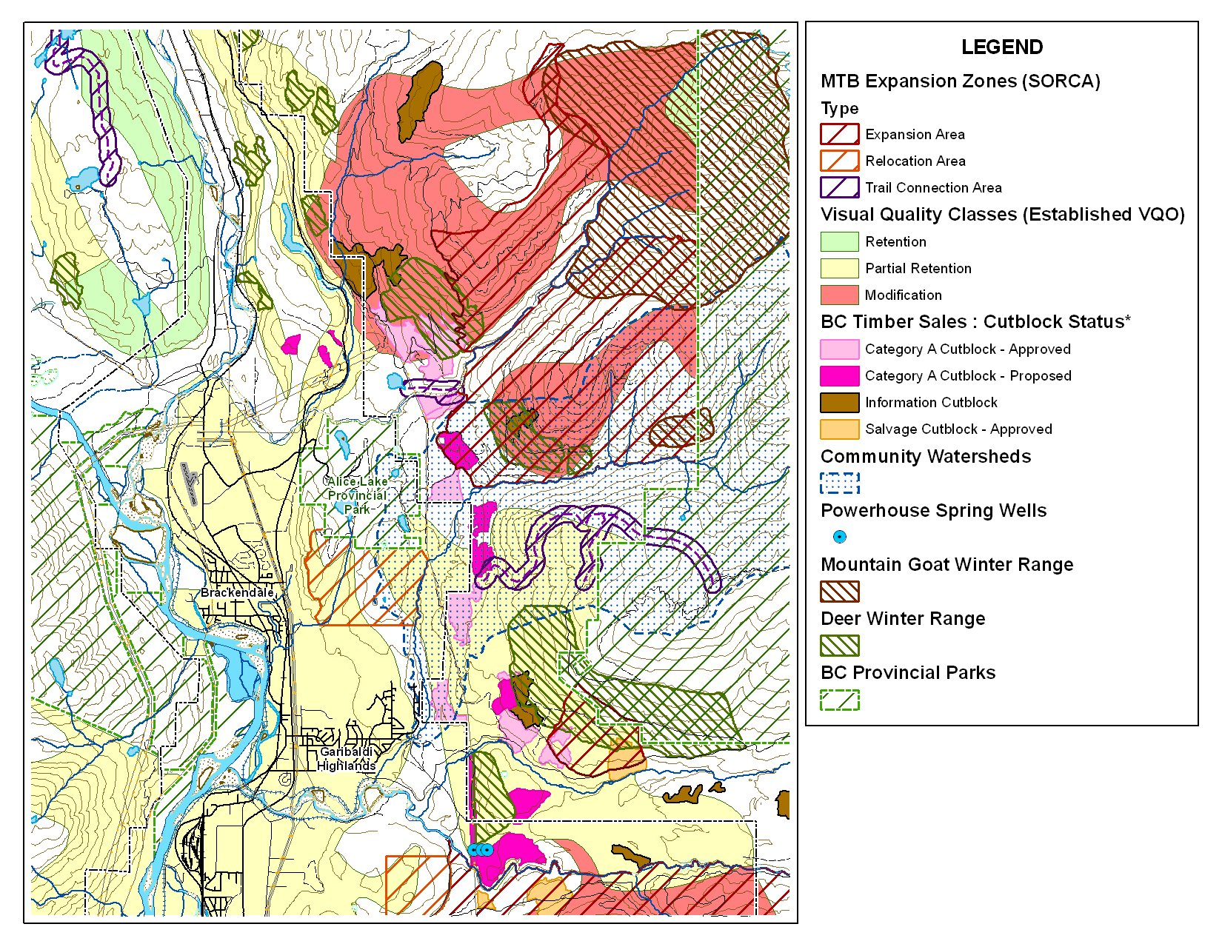
Land planning
Cascade works with stakeholders to mediate and facilitate land use decisions to ensure responsible design and implementation through consultation and analysis of diverse needs and ideas

